Slide 1
INCREDIBLES
ANUSHA REDDY
SUSHMITA
YASH JAIN
MOUNIKA

Slide 2
PNEUMONIA DETECTION USING CONVOLUTIONAL NEURAL NETWORKS BASED CLASSIFICATION

Slide 3
Pneumonia And Its Symptoms
Pneumonia is an infection in one or both lungs. It can be caused by bacteria, viruses, or fungi.
Bacterial pneumonia is the most common type in adults.
Symptoms
coughing that may produce phlegm (mucus)
fever, sweating, and chills
shortness of breath
chest pain

Slide 4
Neural Networks
A neural network is a series of algorithms that endeavours to recognize underlying relationships in a set of data through a process that mimics the way the human brain operates.
Neural Network Layers
Input Layer
Hidden Layer
Output Layer

Slide 5
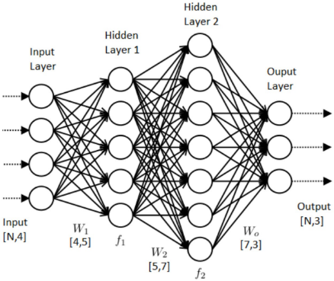
Diagram

Slide 6
Description
Input layer-It’s the layer in which we give input to our model.
Hidden layer-The input from Input layer is then feed into the hidden layer. There can be many hidden layers depending upon our model and data size.
Output layer-The output from the hidden layer is then fed into a logistic function like sigmoid or softmax which converts the output of each class into probability score of each class.

Slide 7
Convolutional Neural Networks
Convolutional Neural Networks or covnets are neural networks that share there parameters
A CNN is a deep learning algorithm which can take in an input image, assign importance to various objects in the image and be able to differentiate one from the other

Slide 8
Layers In CNN
Convolution
ReLu layer
Pooling
Fully Connected

Slide 9
Convolution
In this layer we move the feature to every possible position on the image
In this we remove every negative value from the filtered images and replace it with zeros
In this we shrink the image stack into a smaller size
Here we take our flitered and shrinked images and put them into a single list
ReLu
Pooling
Fully Connected

Slide 10
Data Preprocessing
Data preprocessing is a data mining technique that involves transforming raw data into an understandable format.
Steps In Data Preprocessing
1.Data cleaning: fill in missing values, smooth noisy
data, identify or remove outliers, and resolve inconsistency.
2.Data integration: using multiple databases, data cubes, or files.
3.Data transformation: normalization and aggregation.
4.Data reduction: reducing the volume but producing the same or similar analytical results.
5.Data discretization: part of data reduction, replacing numerical attributes with nominal ones.

Slide 11
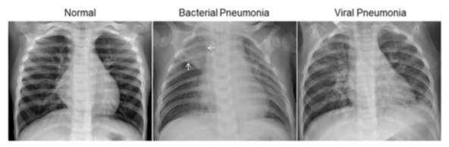
Chest X-ray Dataset Description
The dataset is organized into 3 folders (train, test, val) and contains subfolders for each image category (Pneumonia/Normal). There are 5,863 X-Ray images (JPEG) and 2 categories (Pneumonia/Normal)

Slide 12
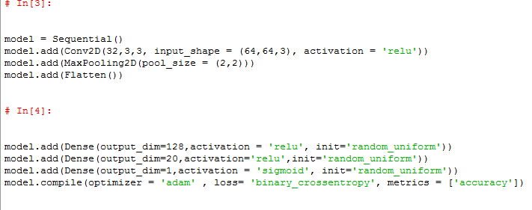
Model Description

Slide 13
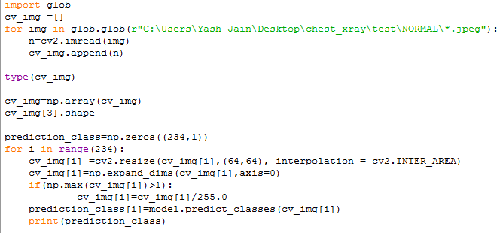
Prediction

Slide 14

Confusion Matrix And Accuracy
[[160, 74]
[161, 229]]
Accuracy
64%

Slide 15
References
https://www.kaggle.com/paultimothymooney/chest-xray-pneumonia
https://www.tutorialspoint.com/python/python_gui_programming.htm

Slide 16
THANK YOU

